Slide 1
Basic structure of a Computer System
UniT 1

Slide 2
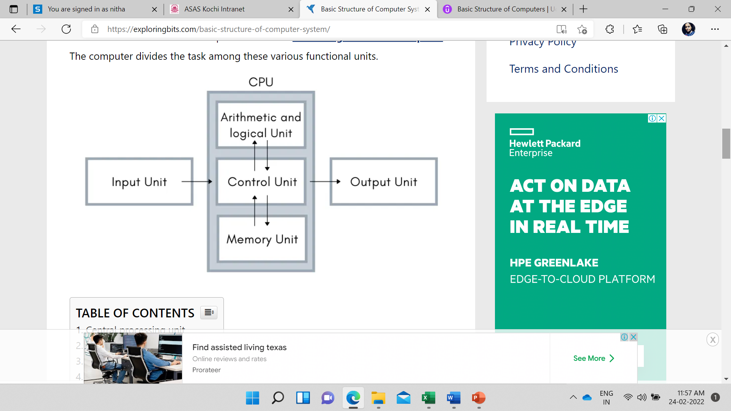

Slide 3
basic structure of computer system
The basic structure of computer system consists mainly of three parts which are
the central processing unit (CPU),
Input devices, and
output devices.

Slide 4
Further, the Central processing unit can be divided into two more parts
i.e. control unit (CU) and
arithmetic logic unit (ALU).

Slide 5
The basic structure of the computer describes a simple concept that the data is entered into the central processing unit with the help of input devices such as a keyboard, mouse, joystick, scanner, secondary storage devices, etc
and then when the central processing unit receives the data from the input devices it has a pre-programmed set of instruction to follow
and the result of instruction execution will lead to output and these output produce are mostly for the user which requires output devices such as a monitor, speaker, etc to understand the processed output data.

Slide 6
These functional units of the computer make the block diagram of the computer. The computer divides the task among these various functional units.

Slide 7
Central processing unit
The computer system’s most important part is the central processing unit.
It is the brain of the computer and controls almost every unit in the computer system.
The central processing unit also contains many parts such as arithmetic and logic units (ALU), control units (CU), and Memory Unit.

Slide 8
Control Unit
The control unit is a very important component of the central processing unit.
The responsibility of the control unit is to take information that is being provided by the memory unit, when the control unit receives instruction from the memory unit then it converts into control signals that are sent to the central processor for further processing.
The control unit also sends instructions to the arithmetic and logic unit to perform the right operation on the instructed operands and in this way the control unit executes the operation.

Slide 9
Arithmetic and logic unit
The work of the arithmetic and logic unit is responsible for performing mathematical instruction (add, subtract, multiply, divide) and logical instruction (greater than, less than, equal to, and, or, not) on the information that is in the form of binary from the control unit and on performing the set of instruction the results are returned to the control unit.

Slide 10
Memory Unit
The Memory unit can be referred to as the storage area in which programs are kept which are running, and that contains data needed by the running programs.
The Memory unit can be categorized in two ways namely, primary memory and secondary memory.
It enables a processor to access running execution applications and services that are temporarily stored in a specific memory location.

Slide 11
Primary storage is the fastest memory that operates at electronic speeds. Primary memory contains a large number of semiconductor storage cells, capable of storing a bit of information. The word length of a computer is between 16-64 bits.
It is also known as the volatile form of memory, means when the computer is shut down, anything contained in RAM is lost.
Cache memory is also a kind of memory which is used to fetch the data very soon. They are highly coupled with the processor. Cache is between main memory and processor.
The most common examples of primary memory are RAM and ROM.

Slide 12
Secondary memory is used when a large amount of data and programs have to be stored for a long-term basis.
It is also known as the Non-volatile memory form of memory, means the data is stored permanently irrespective of shut down.
The most common examples of secondary memory are magnetic disks, magnetic tapes, and optical disks.

Slide 13
Output device
The main responsibility of the output device is to convert the instruction that is provided by CPU as an output which is in machine language or binary format to something that the user can perceive with senses such as to monitor, printer, speaker, projector, etc.

Slide 14
Input devices
The input devices are responsible for receiving the set of instructions that the user requires the computer machine to process.
The input device converts the user action such as moving the cursor and striking keys on the keyboard in the machine-readable binary format of ones and zeros. To receive the instruction from the input device the CPU performs an interrupt and stops all the execution of any program and during that period, it receives information from the input device, and then this information is used when the CPU resumes the execution of the program.

